Slide 1
Academy Lab Projects – Showcase
Zunaira Abdul Aziz
BSSE23058

Slide 2
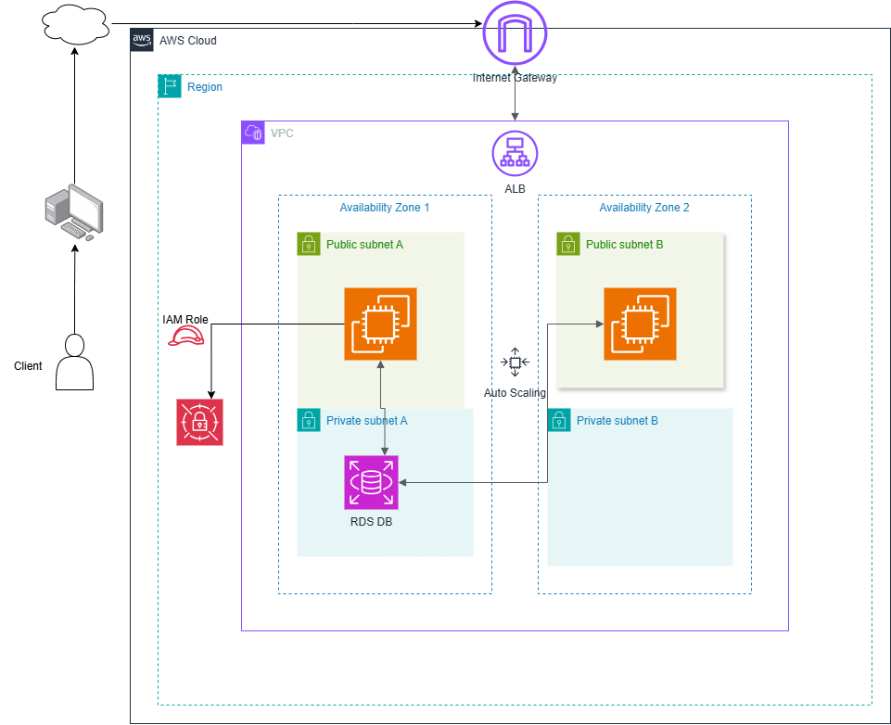
1. Architecture Diagram
Notes:
The entire system resides within a VPC (Virtual Private Cloud) and is distributed across two Availability Zones (AZs), ensuring resilience against zone failure. User traffic enters via the Internet Gateway and is balanced by an Application Load Balancer (ALB), which directs requests to the application servers. These EC2 web servers are managed by Auto Scaling for dynamic capacity adjustments. Crucially, your architecture is secure: the EC2 instances live in both Public and Private Subnets, while the RDS Database is isolated entirely within the Private Subnets, preventing direct public access. The servers use an IAM Role to access resources securely without needing hardcoded credentials.

Slide 3
2. Pricing Summary
Services I used:
Amazon VPC
Public Subnets
Private Subnets
Internet Gateway (IGW)
NAT Gateway
Application Load Balancer (ALB)
Amazon EC2
Auto Scaling Group (ASG)
Amazon RDS (MySQL)
AWS Secrets Manager
Amazon EBS (gp3)

Slide 4
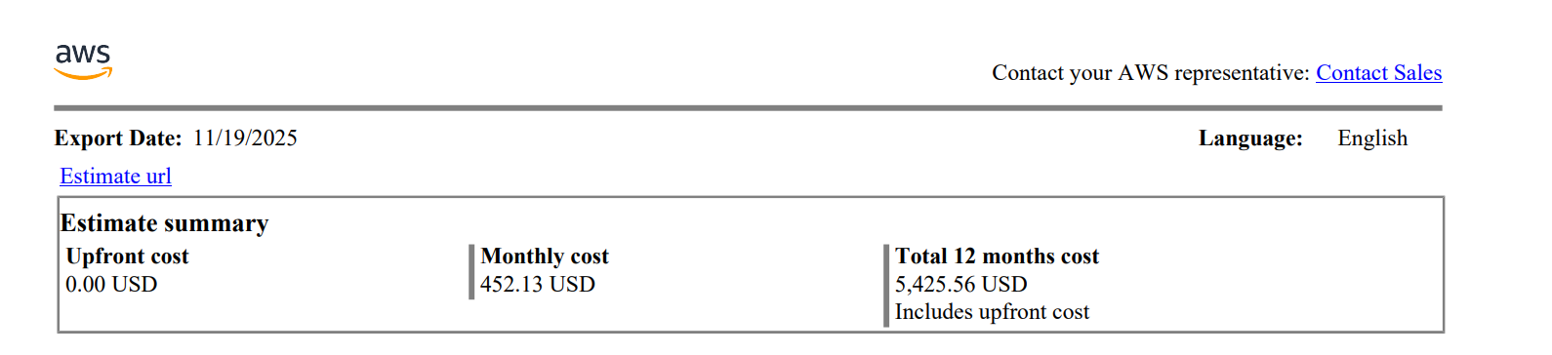
2. Pricing Summary

Slide 5
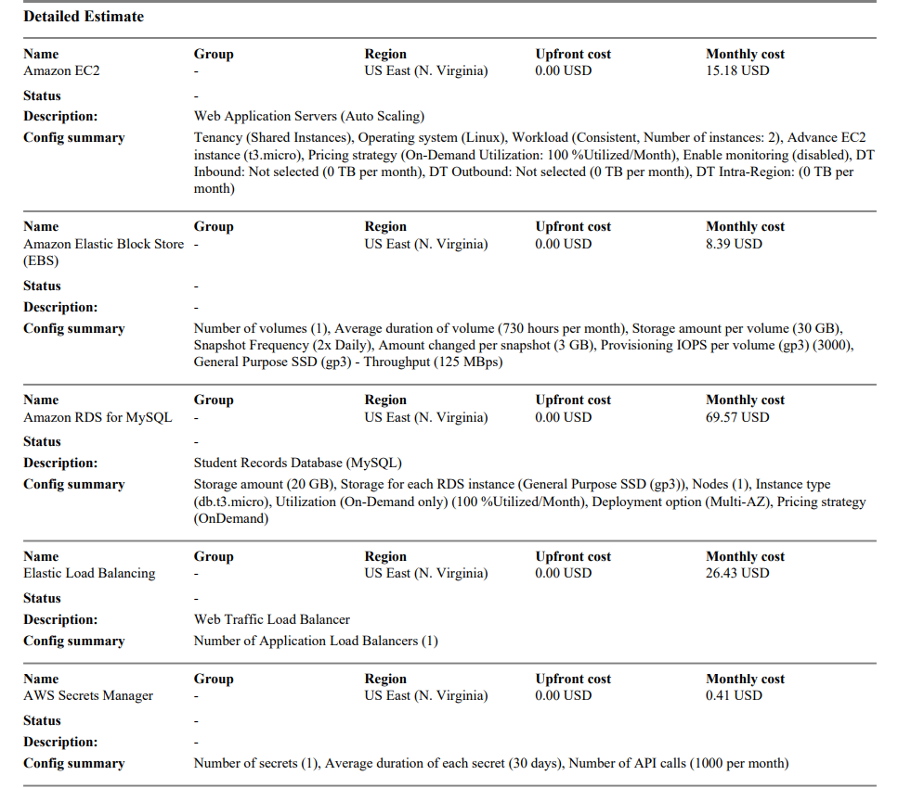

Slide 6
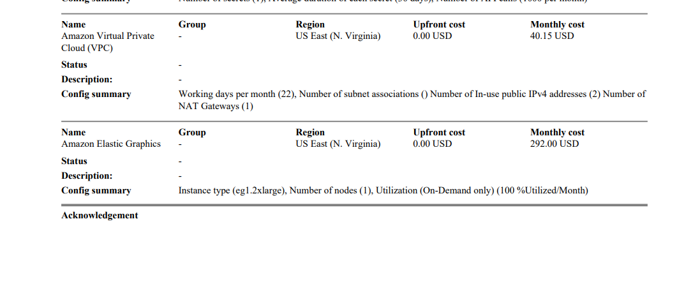

Slide 7
3. Capstone ELB Link + Screenshot of Your Website
http://bsse23058-load-balancer-1345674203.us-east-1.elb.amazonaws.com/
http://bsse23058-load-balancer-1345674203.us-east-1.elb.amazonaws.com/students
Notes:
The links to access the website

Slide 8
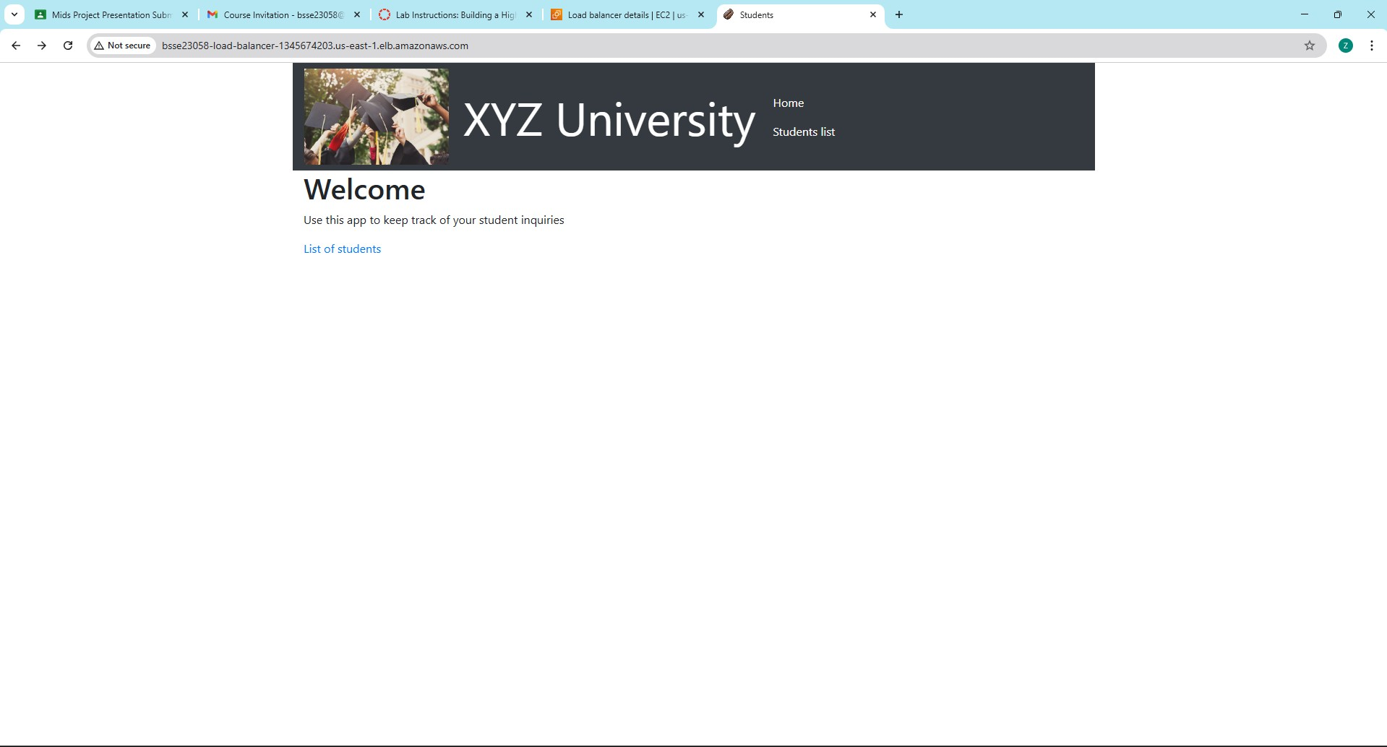
Screenshot of Your Website
<Put your diagram here. Refer to the slide notes for more information.>
Notes:
Main page of website

Slide 9
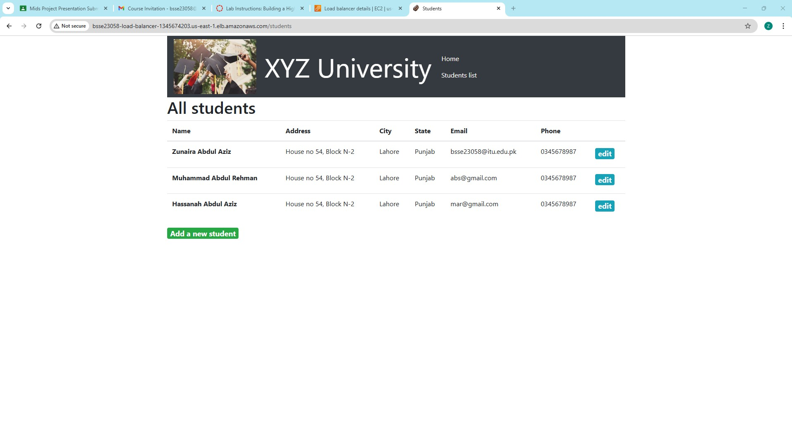
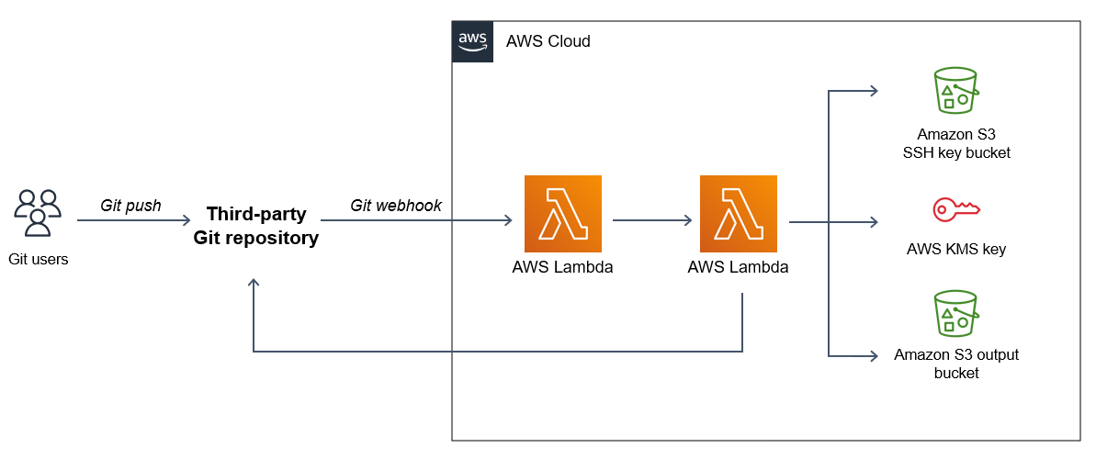
Architecture diagram of the solution: Example
Notes:
Shows the students list

Slide 10
4. Load Testing Results
November 9th: Setting Up the System
Parameter | Min | Desired | Max
Capacity | 2 | 2 | 3 (Later changed to 6)
Initial State | 2 instances running. System verified Auto-Healing (replacing failed instances).
Notes:
The initial setup of the highly available application on November 9th confirmed the proper function of the Auto Scaling Group's core feature: auto-healing. The ASG was initially configured with a Minimum capacity (Min) of 2 and a Desired capacity of 2, meaning it started with two running EC2 instances. The Activity History log confirms the initial launch of these two instances. Crucially, the logs then show four subsequent successful events demonstrating auto-healing: two instances were flagged as unhealthy and terminated, and the ASG immediately launched two new instances to replace them, ensuring the running capacity remained constant at the Desired capacity of 2. This verifies that the system is resilient and capable of maintaining service availability by automatically recovering from instance failures.

Slide 11
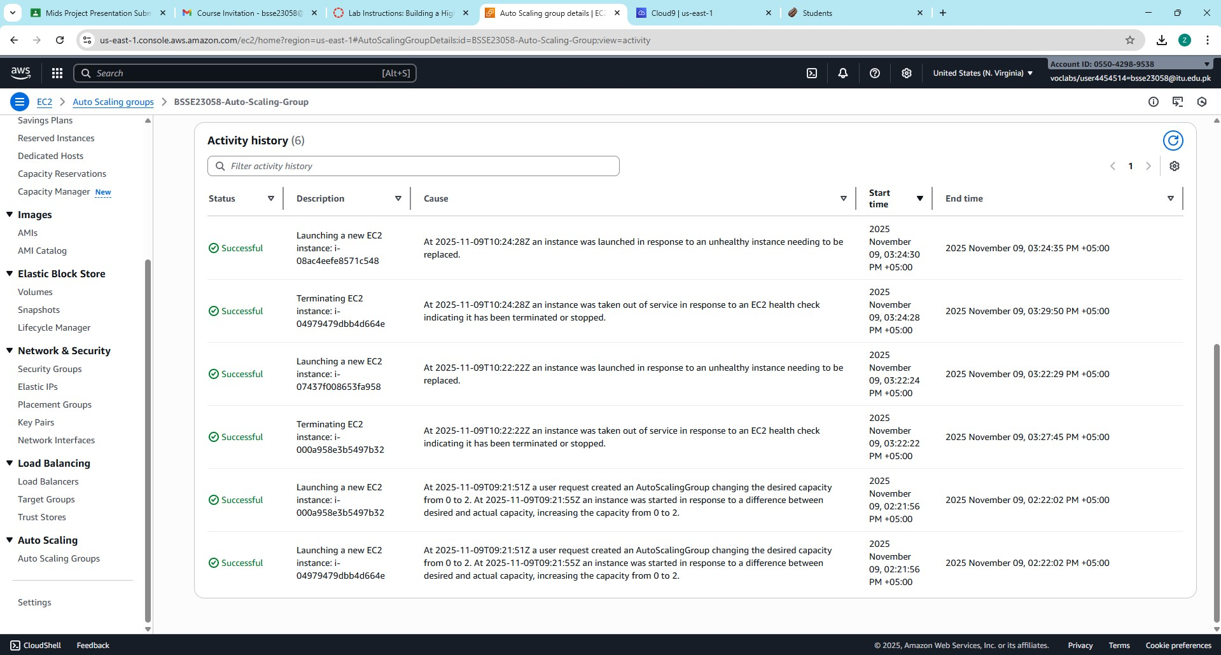

Slide 12
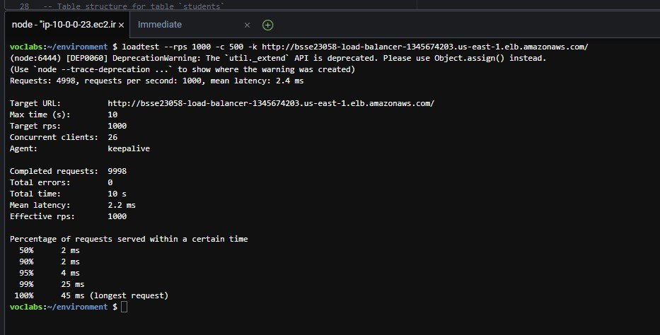
Thank you

Slide 13
4. Load Testing Results
November 19th: Testing and Scaling Events
Event | Load (RPS) | Resulting Latency | Scaling Action | # Instances
Test 1 | 1,000 | 2.2 ms (Excellent) | No Scale (Load too low) | 2
Manual Scale | N/A | N/A | User forced Desired Capacity from 2 to 4 | 4
Test 2 | 4,000 | 479 ms (Severe Degradation) | Auto Scaling Triggered | 4 (Bottlenecked)
Scale Down | Load Stopped | N/A | Automatic Scale-In (Alarm Low) | 2 (Final Capacity)
Notes:
The core goal of achieving scalability was successfully demonstrated on November 19th. An initial low load of 1,000 RPS was handled flawlessly (latency: 2.2 ms), proving the initial 2-instance setup was effective for normal traffic. To force a scaling event, the capacity was manually increased to 4 instances. A subsequent heavy load of 4,000 RPS caused severe degradation (latency spiked to 479 ms), confirming the application was bottlenecked and the Auto Scaling Triggered. Though the maximum scale-out was not fully captured, the policy proved active by successfully executing an Automatic Scale-In when the load test stopped, reducing the capacity from 4 instances back down to the final, cost-optimized level of 2 instances (as seen in the capacity logs).

Slide 14
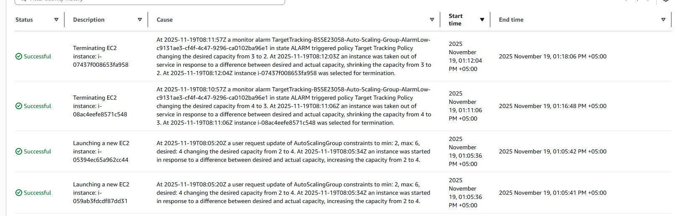

Slide 15
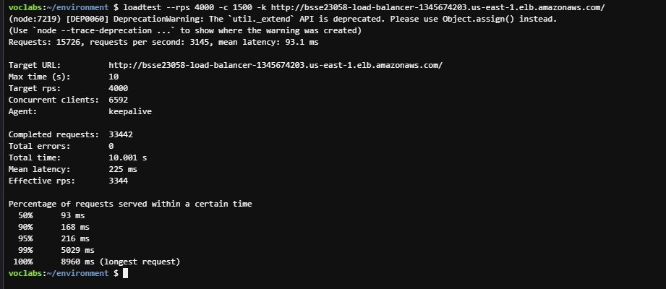

Slide 16
5. What You Learned From This Project
The project taught us the key concepts of modern cloud architecture by taking a basic web app and making it secure, reliable, and able to handle massive traffic spikes.
Decoupling for Strength: We moved the database (RDS) off the web server (EC2), making our application easier to update and preventing the whole system from failing if one part broke.
Always On (High Availability): We used an Application Load Balancer (ALB) and an Auto Scaling Group (ASG) across two different data centers (Availability Zones). This means if one server or even one data center goes down, our website stays online.
Automatic Scaling: We proved the system could handle load by automatically launching servers when stressed (though manual intervention was needed initially) and then automatically turning them off when traffic dropped (Cost Optimization).
Security Best Practices: We secured the database by placing it in private subnets (hidden from the public internet). We also eliminated the risk of exposed passwords by using AWS Secrets Manager and IAM Roles instead of hardcoding credentials.
Planning and Budgeting: We learned to use the AWS Pricing Calculator to determine the cost of our design before building it, a crucial skill for any cloud engineer.

